Slide 1

GameCo Marketing Budget Plan 2017
Izabella Lorenz

Slide 2
CONTENT
Expectations
Historical Market Trends
Data insights
Regional sales proportions
Regional sales by platform
Regional sales by genre
4. Revised expectations
5. Recommendations

Slide 3
GAMESCO current EXPECTATIONS around sales for the various geographic regions assumes that the sales in those regions have stayed the same over time

Slide 4
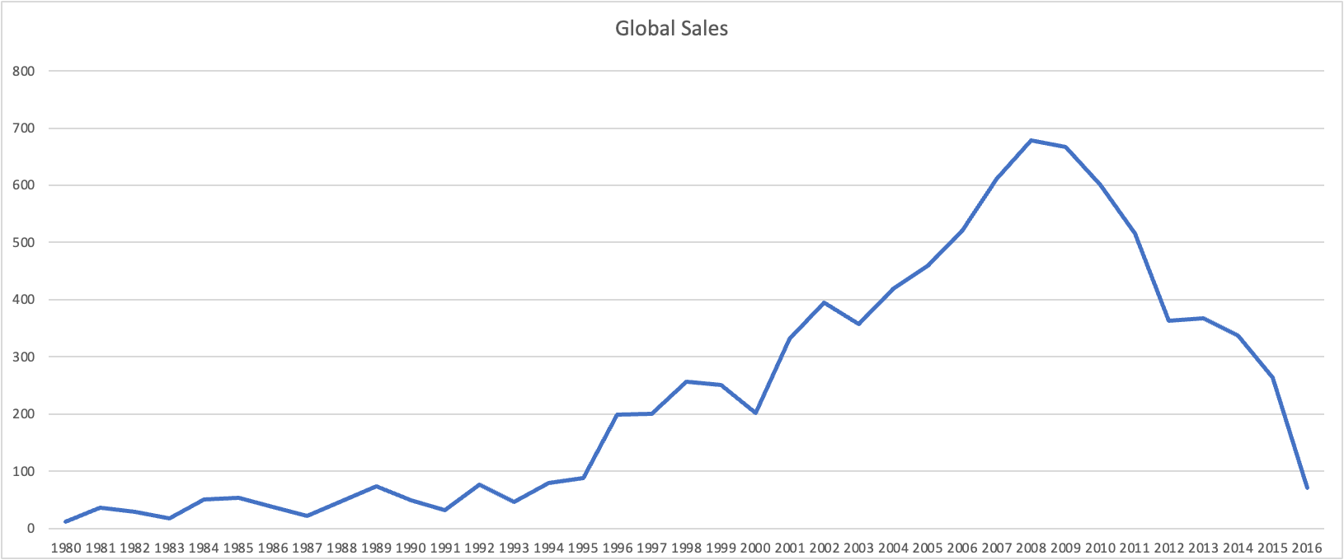
games GLOBAL market
From 1980 until 2008 the number of game units sold globally increased
The global sales peaked in 2008 reaching nearly 680 million units sold
From 2008 onwards the sales decreased every, reaching all time low in 2016

Slide 5
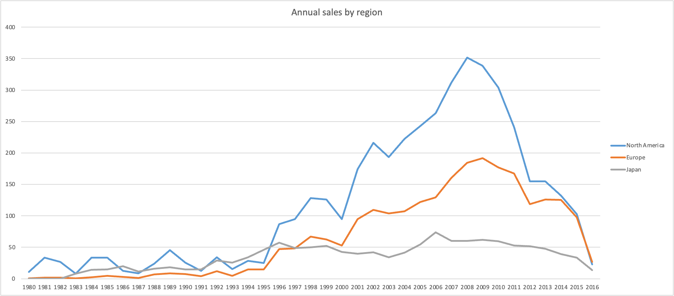
Historical REGIONAL trends
After steady growth from 2008 onwards sales are declining for all regions
Until 2014 North America was leading the global sales of games
In 2014 the sales in North America had dropped to the same level as the sales in Europe
Japan's sales never took off and have always been the slowest out of all regions

Slide 6
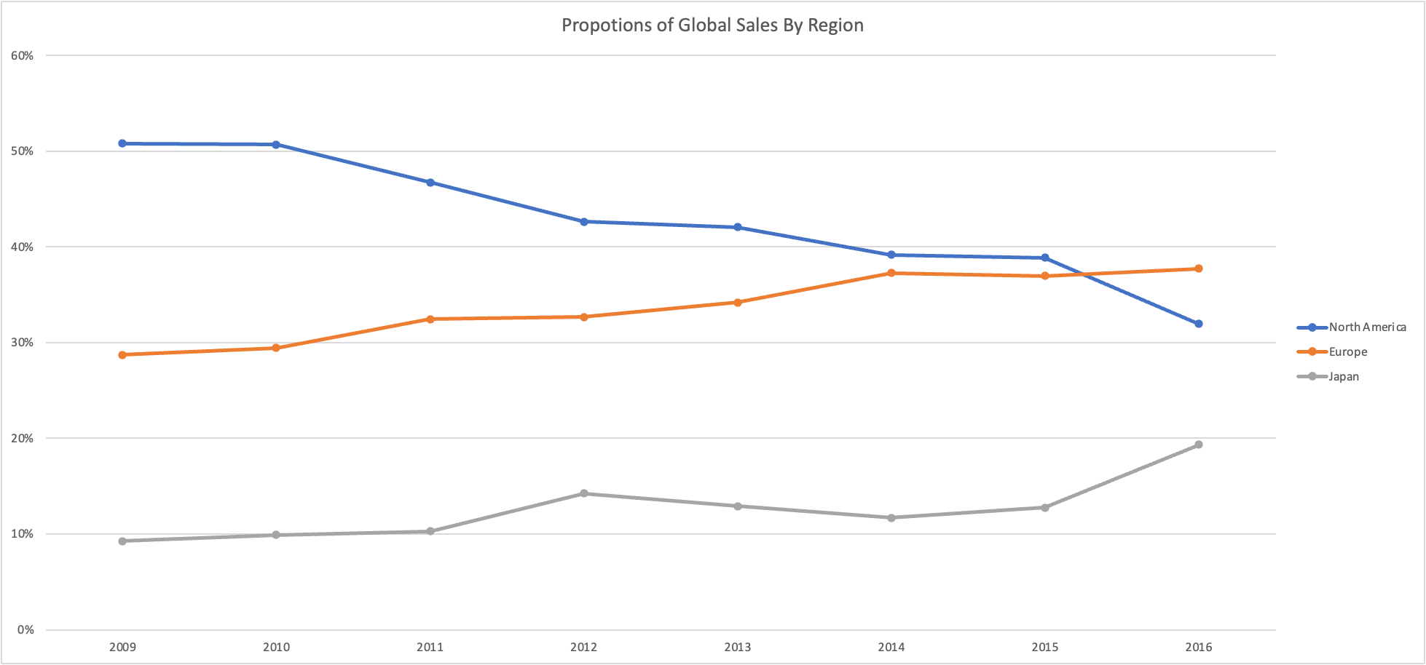
DATA INSIGHTS​
REGIONAL SALES PROPOTIONS
North America showing declining sales trends- in 2016 only accounted for 35% of global sales
European sales steady increase and surpassing North America sales.
Japan sales the lowest proportion of global sales

Slide 7
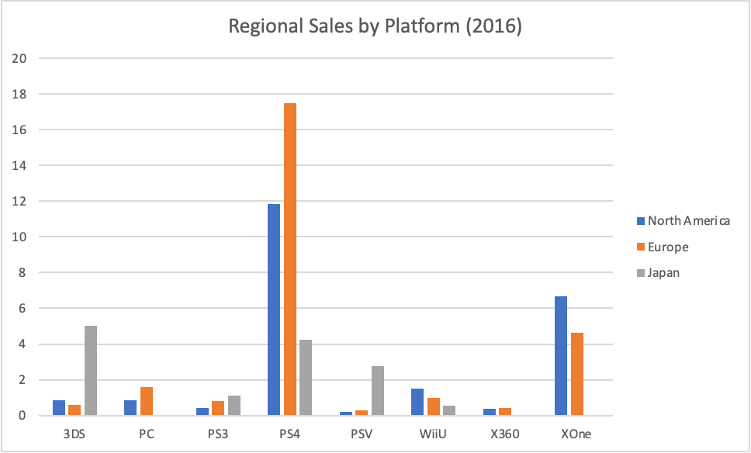
DATA INSIGHTS
Regional sales by platform
In 2016 PS4 was market leader in all 3 regions
XOne was the second most sold platform in Norh America and Europe
X360 sales declined in all 3 regions

Slide 8
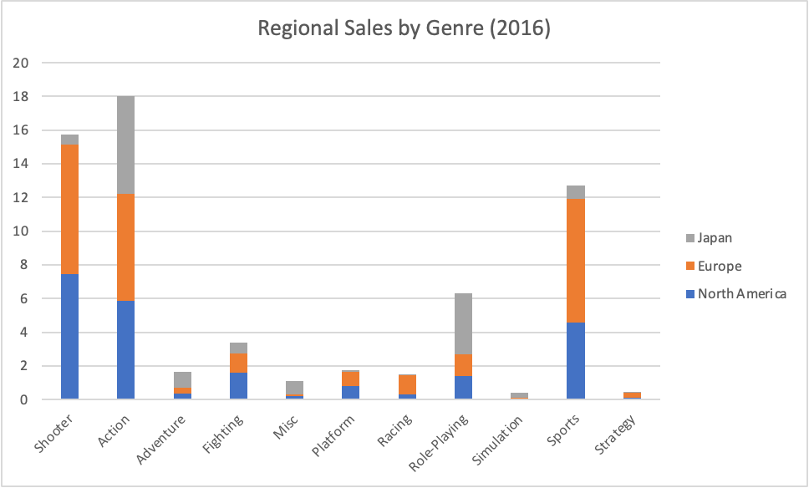
DATA INSIGHTS​
Regional sales by genres
In 2016 Action Games were the most sold genre games
Shooter Games are most popular in North America and Europe
Strategy & Simulation have the lowest sales

Slide 9
Revised STATEMENT around REGIONAL SALES OBSERVE a SUBSTANTIAL DECLINE IN SALES IN NORTH AMERICA AND A STEADY INCLINE TREND IN SALES IN Europe

Slide 10
Recommendations
Gather more insights on the upward trend in Europe
01
Analyze the decline of sales in North America – what is causing this downward trend
02
Continue investing and marketing of PS4
04
Consider local genre preferences
05
Gather more insights on the gaming market in Japan
03

